Slide 1

Case Study- P&G
How many times we have heard from people to look from a different perspective to a problem and it might get solved. Today let’s understand how a developed company thought like a startup and looked from a fresh perspective and developed revolutionary products.

Slide 2

About the Company
The Procter & Gamble Company is an American multinational consumer goods corporation headquartered in Cincinnati, Ohio, founded in 1837 by William Procter and James Gamble Procter & Gamble makes lots of cleaning products. They’re constantly trying to improve and revitalize their cash-cow products, over the years their portfolio has shown many great companies such as Amway, Whisper, etc.

Slide 3
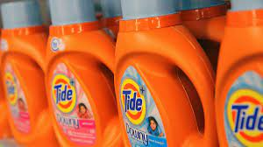
The Problem they Recognised
Although P&G is constantly improving their products, some of them specifically cleaning fluid had low sales. Despite improving all day they were unable to create a better cleaning fluid. The company’s executives knew it was time to disrupt the industry, and they couldn’t do it from within. So they brought in an outside agency, Continuum, to help out.

Slide 4

How They Approached To It?
Bringing in Continuum was a life-changing incident for the company as a whole. They started looking at the problem from a startup point of view Rather than mixing up another batch of chemicals, Continuum’s team decided to watch people as they mopped. They focused on recording, testing, and rapid iteration during their investigation phase They watched a test subject clean up spilled coffee grounds. Rather than breaking out a mop, the subject swept up the dry grounds with a broom, and then wiped the remaining fine dust with a damp cloth. Such observations were recorded thousands of times and many iterations were done and they concluded that many day to day cleaning jobs require only a damp cloth or a broom. No mop.

Slide 5
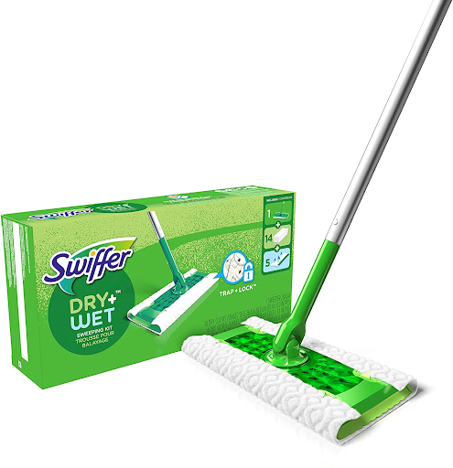
The Solution to the Problem…
These observations were an eye-opener for P&G . They realized that the problem was never the cleaning fluid but the mop. They could do this by looking at the problem from a different angle. They looked at the makeup of floor dirt (which is part dust, which is better picked up without water10) and innovated on the cleaning tool itself, giving P&G a $500M-dollar innovation—the Swiffer, a more user-friendly style of mop—in the otherwise stagnant cleaning industry. And hence with the help of analysis, a new tool was invented in the cleaning industry.

Slide 6
Summary of the Case Study
Taking the startup approach, and focusing on disruption in the Empathy Stage, is a good way to rediscover what’s possible and take off enterprise blinders as P&G did and developed a new product Swiffer Using the customer development approaches it is possible to discover new problems and see the customer on a one-to-one basis. Despite the temptation to use surveys and quantitative research, the insights from one-on-one observation can unlock an entire market segment.

Slide 7

Analytics Lesson Learnt
Sometimes thinking as a startup is the best way to look at a problem even for intrapreneurs. In this way, you may be able to move a cash cow product—lucrative, but not growing—back to a high-growth industry If you do not understand the customer sentiment then someone else will.

